Slide 1

Serving Up Success at Tasty Bytes
Executive Summary
Context/Intro
Data Overview
Exploratory Data Analysis
Feature Engineering
Modeling Approach
Model Performance
Conclusions
A data-driven approach to predict High-Traffic Recipes
Adrien Caudron
Feb 25th,2023
Notes:
0 > 30 s

Slide 2
Introduction
Business Question:
Can we predict high-traffic recipes with at least 80% precision?
Tasty Bytes
Founded in 2020 during the Covid-19 pandemic
Started as a recipe search engine to help people with cooking during the lock-down.
Now offers full meal plans for a monthly subscription, providing healthy and budget-friendly options for families.
Project context and challenge
Tasty Bytes Product team has discovered that featuring a popular recipe on the homepage drives high traffic to the website.
We have historical data on website traffic related with recipe specificities.
Our challenge is to build a predictive model that can accurately identify recipes that will generate high traffic at least 80% of the time.
Notes:
30s > 1’30 mn

Slide 3
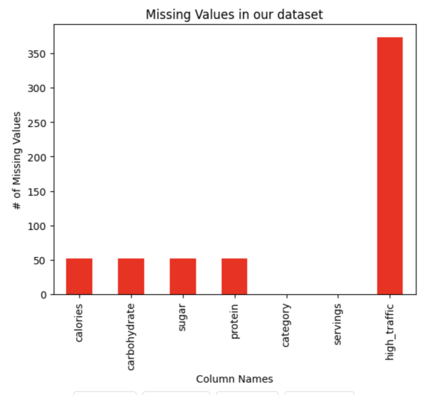
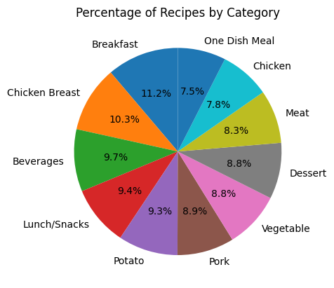
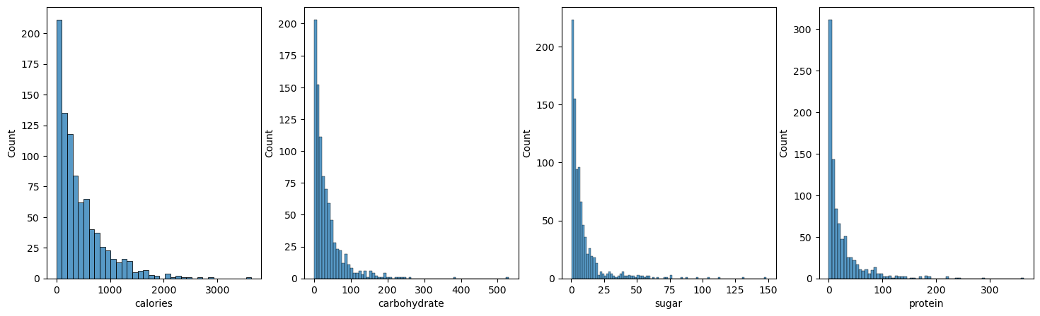

Data Overview (1/2)
Missing Values in our dataset
Percentage of Recipes per Category
Quality Control /
Data Transformation
dataset columns : web traffic, calories, macro-nutrient content, number of servings, and category.
The missing data in calories and macro-nutrient columns (5.5%) will be imputed using median values .
The category column will be simplified by merging "Chicken Breast" and "Chicken” together.
Statistical distribution of calories and macro-nutrients columns
Notes:
1’30 > 2’30 mn

Slide 4
Data Overview (2/2)
Statistical Significance and Predictability
calories, carbohydrate, and sugar columns are all statistically significant (p-values <0.5) when associated with the column high_traffic .
Therefore, the null hypothesis that an association between those variables and high_traffic is likely to have occurred by chance alone can be rejected.
A feasibility test using a simple logistic regression with only calories, carbohydrate, and sugar as predictors and high_traffic as target, returned an accuracy of 59%, validating the predictive power of our dataset.
Assumptions :
The high_traffic column will be the target variable
The missing data in the high_traffic column will be associated with ’Other’ traffic, and the column will be transformed into Boolean data.
Based on the above assumptions and observations, the historical dataset contains 574 cases of 'High' traffic and 400 cases of 'Other' traffic, making it suitable for performing binary classification using machine learning.
Column Name | Variable Type | Data Type | Non-null count (% non-null)
high_traffic | Target (response) | Categorical | 574 (60.7%)
calories | Feature (predictor) | Continuous (float) | 895 (94.5%)
carbohydrates | Feature (predictor) | Continuous (float) | 895 (94.5%)
sugar | Feature (predictor) | Continuous (float) | 895 (94.5%)
protein | Feature (predictor) | Continuous (float) | 895 (94.5%)
category | Feature (predictor) | Categorical | 947 (100%)
servings | Feature (predictor) | Categorical | 947 (100%)
Notes:
2’30 >3’30 mn
Statistical significance is a term used in statistics to indicate whether the difference between two groups or the association between two variables is unlikely to have occurred by chance alone.

Slide 5
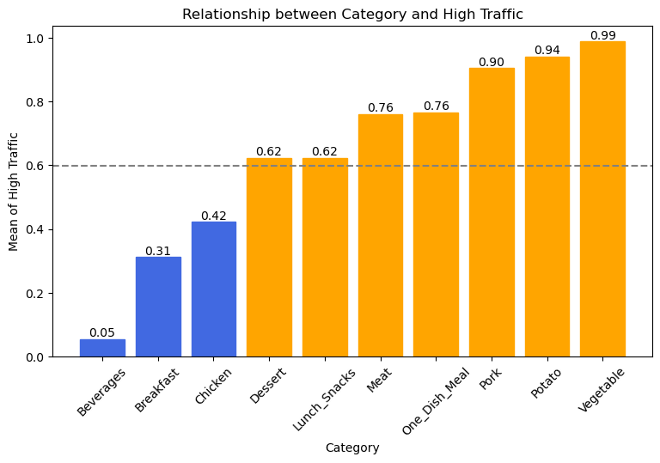
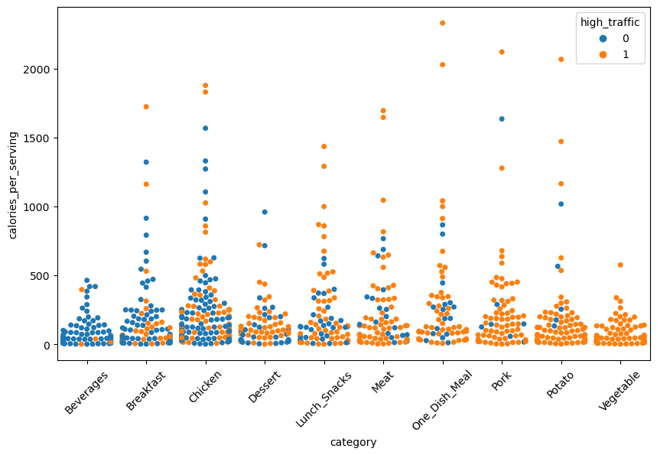
Exploratory Data Analysis (EDA)
Rich meat and vegetable dishes (including potato) are more prevalent among Tasty Bytes users, possibly due to their filling and tasty nature and association with special occasions such as holidays or thanksgiving. This is coherent with Tasty Recipe’s vocation of providing healthy and budget-friendly options for families
Beverages, breakfast, and chicken-based meals are generating less traffic. They may be less popular due to their less unique taste and convenience factor. Chicken is considered lean meat and can be perceived as less filling. Beverages and breakfast could be simpler to realize, making the Tasty Bytes users less likely to look for those recipes.
→ Tasty Bytes indicates that users are likely seeking healthy and delicious food options.
Notes:
3’30 > 5 mn

Slide 6
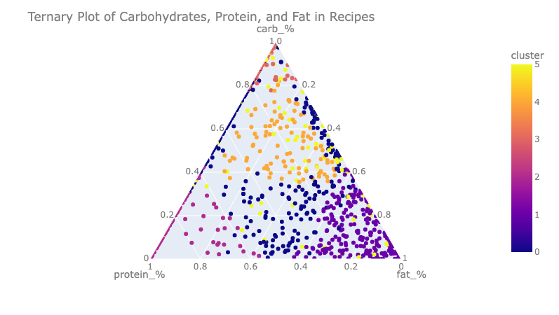
Feature Engineering
We used a modified and simplified version of the Atwater system to estimate the grams of Fat from other macro-nutrient and calories columns :
We used the transformed servings columns to calculate the calories and macro-nutrients per serving.
The Mayo Clinic recommends the following ranges for balanced foods:
Protein > 10% & Protein < 35%
Fat > 20% & Fat < 35%
Carb >= 45% & Carb < 70%
Recommended Daily intake for an adult: 1,600 calories/d
No more than 30g of sugar per day
We adapted those cut-offs values to have slightly broader range and create 6 clusters of recipes
Fat (g) = (Total Calories - (Protein (g) * 4 + Carbohydrates (g) * 4 + Sugar (g) * 4)) / 9
Type 0: Somewhat unbalanced foods
Type 1: High fat
Type 2: High protein
Type 3: High carb
Type 4: Healthier choices
Type 5 : Unhealthy recipe (high sugar)
Notes:
5’00 > 7’00 mn

Slide 7
Modeling Approach
Binary classification problem: Our dependent variable, high_traffic, is a categorical variable that can only take one of two possible values, making binary classification the most appropriate approach for this problem.
Key Performance Indicators:
Precision: proportion of true positive predictions among all positive predictions.
Recall: proportion of true positive predictions among all positive instances.
AUC (Area Under the receiver operating Curve) : measures how well the two classes are separated.
F1 score: harmonic mean of precision and recall
→ A model with a precision score above 80% will predict high-traffic recipes accurately 80% of the time.
F1, recall, and AUC scores above 80% are also desirable / Indicators of solid performance, limiting false negatives and adequate separation of our two categories.
Preprocessing methods steps before Modeling:
Fixing Class Imbalance: we used a SMOTE (Synthetic Minority Over-sampling Technique) approach to ensure we have the same number of values for the categories High and Other in the high_traffic target column.
Converting numerical variables to bins: Fat_% → 'fat_Low', 'fat_Mid’, 'fat_High'
Choosing the adequate features for predictive modeling. We used the RFE (Recursive Feature Elimination) technique to keep only the 13 features with the highest contribution to our target variable: high_traffic
Features selected: 'meal_Beverages', 'meal_Breakfast', 'meal_Chicken', 'meal_Dessert', 'meal_Pork', 'meal_Potato', 'meal_Vegetable', 'type_3', 'type_5', 'fat_Low', 'fat_Mid', 'protein_Low', 'sugar_High
Notes:
7’00 > 9’00 mn
Precision : important if we want to minimize false positive predictions.
Recall : important if we want to minimize false negative predictions, i.e., to ensure that we don't miss high traffic recipes.
The higher the AUC, the better, with a 100% meaning the classes are perfectly separated, and a 50% meaning they are overlapping.
Values of AUC below 70% would indicate the presence of false positives, which we want to avoid in our case.
F1: provides a good balance between precision and recall and is a useful metric to consider in this business case where both precision and recall are equally important.
### Recursive Feature Elimination:
Recursive Feature Elimination (RFE) is a feature selection technique used in machine learning to select a subset of the most important features in a dataset. It is a backward elimination process, where the algorithm starts with all features and then iteratively removes the feature with the lowest contribution to the target variable, until a set of k features is obtained. The contribution of each feature is determined by an estimator, such as a regression model or a decision tree.

Slide 8
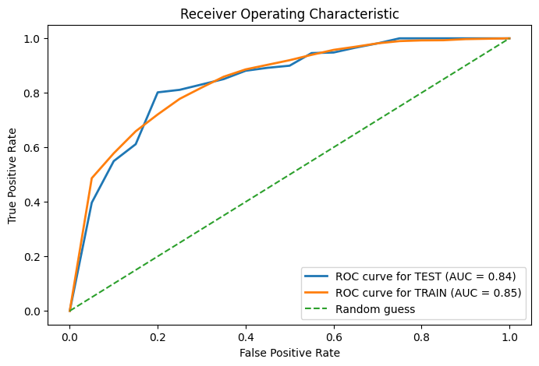
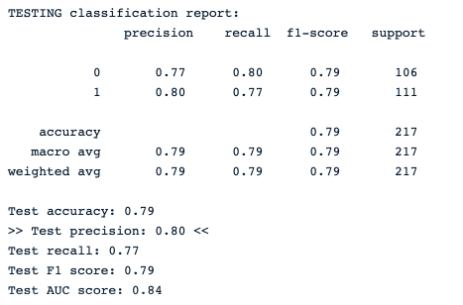
Modeling Performance
Baseline Model: Logistic Regression
Precision = 0.80
Baseline : Logistic Regression
- Test precision: 0.80
- Test recall: 0.77
- Test F1 score: 0.79
- Test AUC score: 0.84
With a precision score above 80%, our baseline model is already able to predict recipes generating high traffic at least 80% of the time.
Notes:
9 > 10 mn
Logistic regression is a statistical method used to analyze the relationship between a binary dependent variable and one or more independent variables.
It estimates the probability of the dependent variable based on the values of the independent variables.
It is commonly used in classification problems.

Slide 9
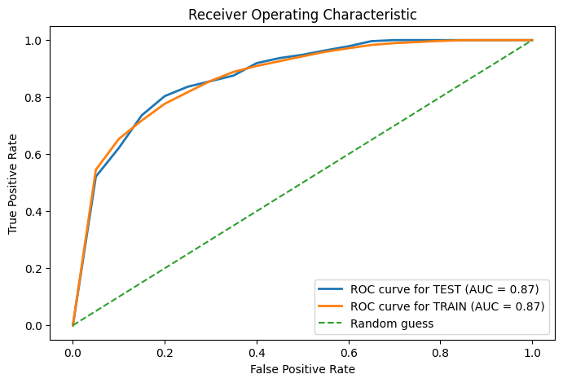
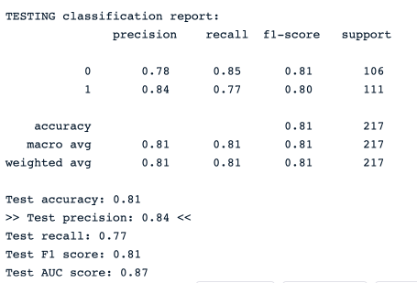
Modeling Performance
Best Model: CatBoost
Precision = 0.84
Best Overall Model : CatBoost
- Test precision: 0.84
- Test recall: 0.77
- Test F1 score: 0.81
- Test AUC score: 0.87
With a precision score above 80%, we can claim that is able to predict recipes generating high traffic at least 80% of the time.
Note: We also tested 2 other high-performing models : SVM and XGboost (not displayed here).
Notes:
10 > 11 mn
CatBoost is a gradient boosting algorithm designed to handle categorical features and produce accurate predictions with less training time than other models.
It uses a combination of ordered boosting, random permutations, and gradient-based optimization to achieve high performance on various tasks such as classification, regression, and ranking.
The CatBoost model is the one with the highest precision, correctly predicting recipes that leads to high traffic 84% of the time on the test dataset. However it will produce more false negatives than other tested model such as SVM

Slide 10
Conclusions
Our data enabled us to build predictive models that consistently predict recipes generating high traffic at least 80% of the time. Catboost, XGBoost, SVM, and Logistic Regression are our recommended algorithms for this task.
Recommendations to further improve model performance:
Obtain more and higher-quality data
Improve feature engineering
Fine-tune machine learning models with more hyper-parameter tuning and cross-validation
Deploy models in production and implement MLOps to detect possible drift in new data.
By implementing these recommendations, we can improve the accuracy and reliability of our predictive models and ensure that they continue to perform well over time.
Notes:
11 > 12 mn
Too many missing data
Fat% computations didn’t match. Should be obtained from recipe.
Feat Engineering : feature interaction / generate polynomial features by multiplying, adding, or subtracting original features
Hyper parametrization: n_etimators, depth, early stopping etc. – some regularization technique were used here / that’s all

Slide 11
Thanks!

Slide 12
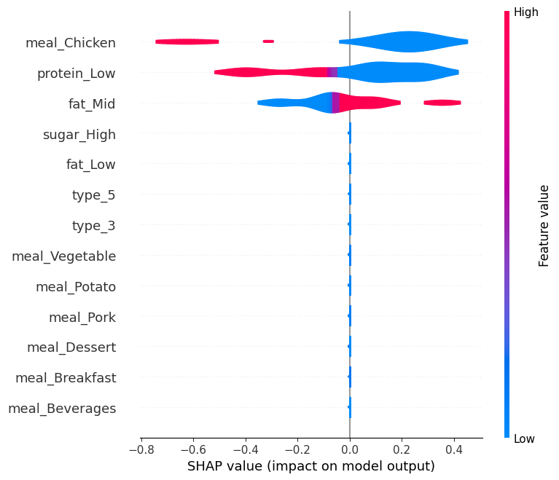
Modeling Performance
Shapley Additive Explanations (SHAP) Analysis for CatBoost model
Our analysis reveals that high traffic on the Tasty Bytes website is associated with recipes that are:
NOT chicken-based
NOT low in protein
Moderately-High in Fat content.
Chicken dishes, low protein meals, and unbalanced fat content are associated with lower traffic and will likely negatively impact the website traffic and popularity.
These findings corroborate our earlier observations:
Tasty Bytes visitors' primary interest lies in hearty and satisfying recipes suited for family gatherings.
SHAP Results for CatBoost Model
Notes:
SHAP (SHapley Additive exPlanations) is a method used to explain the output of any machine learning model.
It involves assigning feature importance scores to each input variable to determine their impact on the model's output.
The scores are calculated based on Shapley values from cooperative game theory.

Slide 13
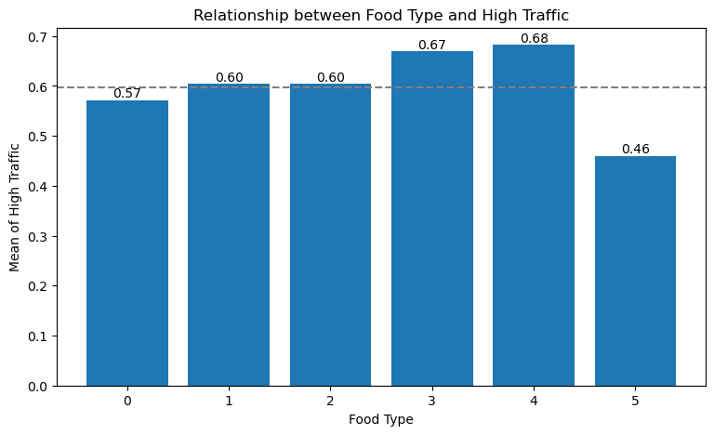
Feature Engineering / EDA
Type 0: Somewhat unbalanced foods
Type 1: High fat
Type 2: High protein
Type 3: High carb
Type 4: Healthier choices
Type 5: Unhealthy recipe (high sugar)
Type 3 (High-carb) recipes: typically, pasta, bread, and rice are affordable and satisfying, making them a popular choice for people on a budget or with limited access to diverse ingredients.
(Type 4) Healthier choice recipes could be popular due to being well-rounded and perceived as healthier.
Type 5 (High sugar) recipes, like desserts and fruity beverages, can be unpopular due to being perceived as unhealthy.
→ This resonates well with the reason d’être of Tasty Recipes, created during the pandemic as a search engine for recipes, helping people find ways to use up the limited supplies they had at home, and which now offer full meal plans for a monthly subscription, providing healthy and budget-friendly options for families.
Notes:
Type 3 (High-carb) are foods like pasta, bread, and rice, which are often very affordable and easy to find and cook, making them a popular choice for people on a budget or without access to diversified food. Tasty Bytes was launched during the COVID pandemic, with goal to provide easy to cook recipe for people with limited access to fresh and varied ingredients. High-carb foods can also be quite satisfying and filling, which can make them a good choice for people who want to feel full and satisfied after a meal.
The popularity of the "Healthier choices" recipes (Type 4) could be due to the fact that they offer a well-rounded and satisfying meal, appealing to a wider range of people. They can also be perceived as a healthier option, which could also contribute to their popularity.
Recipes that fall into Type 5 (high sugar) are often considered unhealthy due to their high levels of sugar, which can contribute to a range of health problems if consumed excessively. Desserts and/or fruity beverages typically correspond to this type. It is possible that recipes in this category could be unpopular if they are perceived as too unhealthy.

Slide 14
Tasty Bytes
At the end of the data exploration analysis, we end up with those different columns:
'daily_intake_%’
'meal_Beverages’
'meal_Breakfast’
'meal_Chicken’
'meal_Dessert’
'meal_Lunch_Snacks’
'meal_Meat’
'meal_One_Dish_Meal’
'meal_Pork’
meal_Potato’
'meal_Vegetable’
'type_0’
'type_1’
'type_2’
'type_3’
'type_4’
'type_5’
'servings’
'high_traffic’
'calories_per_serving’
'carbohydrate_per_serving’
'sugar_per_serving’
'protein_per_serving’
'fat_per_serving’
'weight_per_serving’
'carb_%’
'protein_%’
'fat_%’
'sugar_%’
'fat_Low'
'fat_Mid'
'fat_High’
'protein_Low’
'protein_Mid’
'protein_High’
'carb_Low’
'carb_Mid’
'carb_High’
'sugar_Low’
'sugar_Mid’
'sugar_High'

